Slide 1
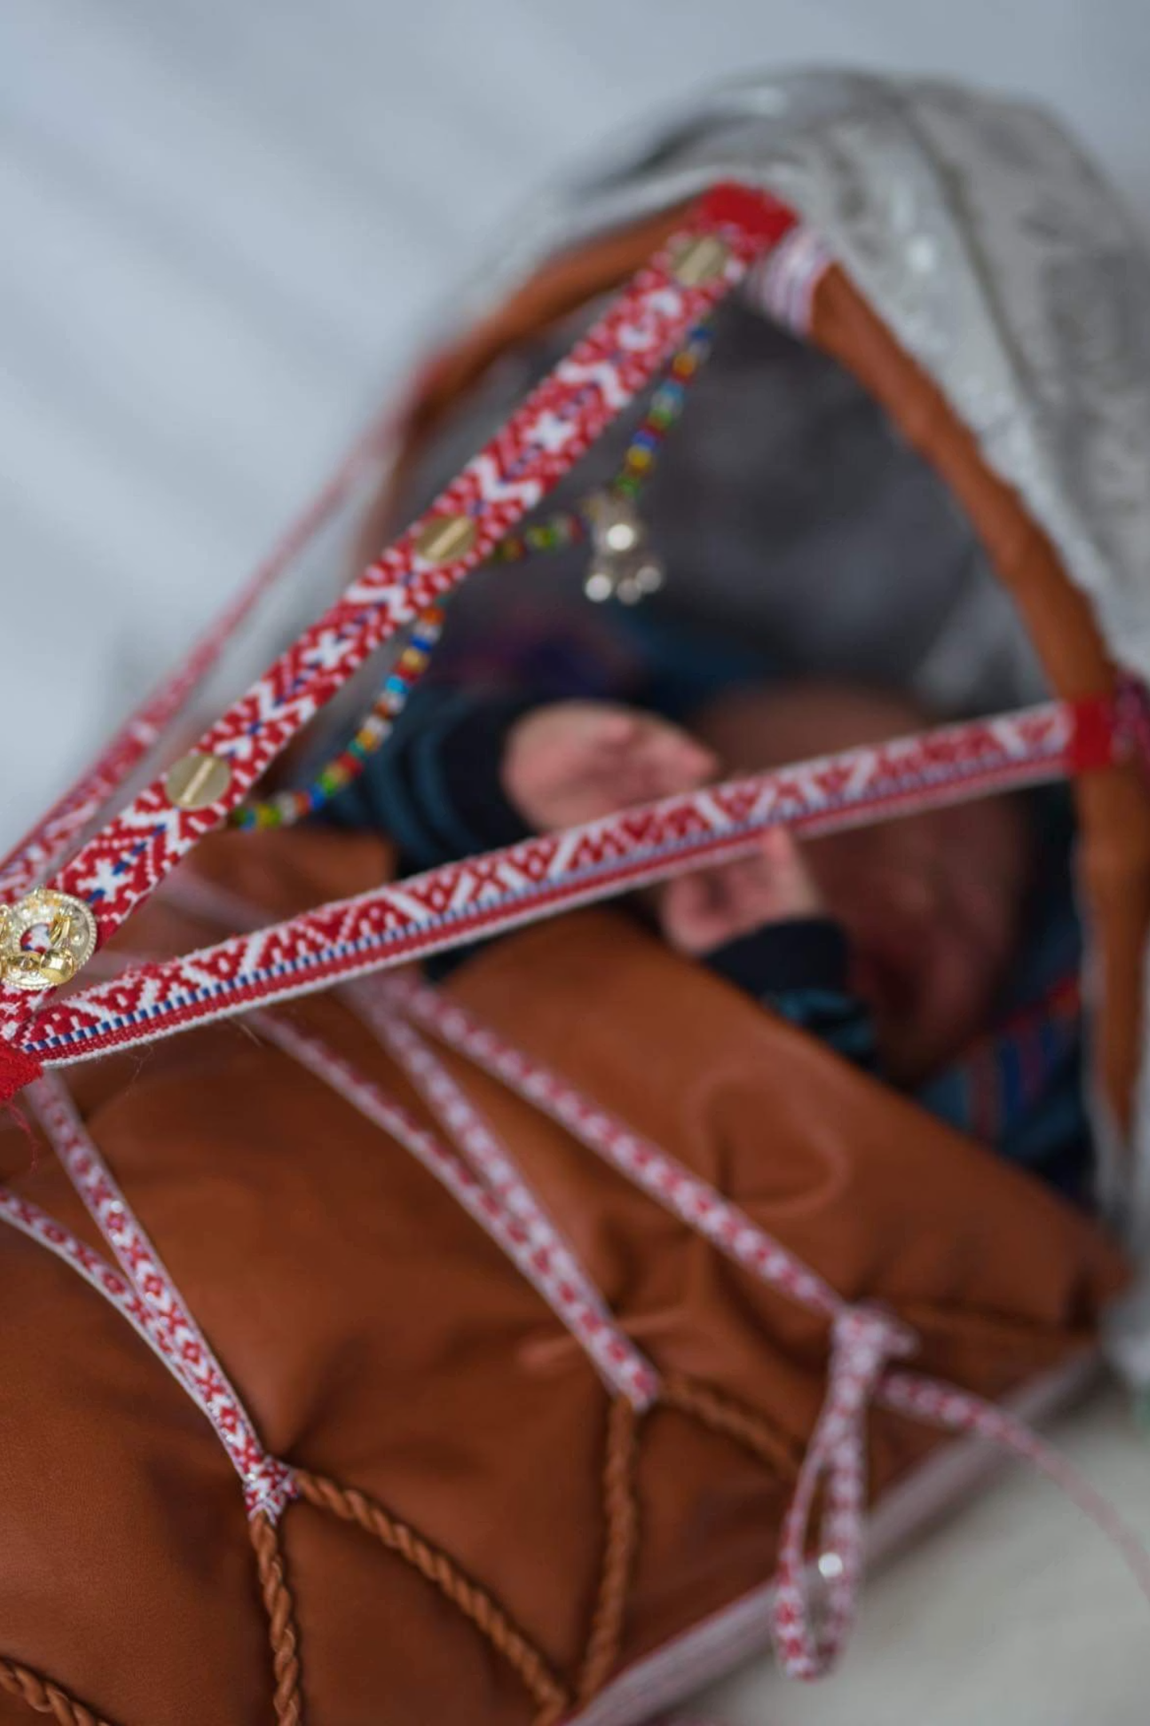
Advancing Indigenous Maternal & Newborn Health
Presented at ICM Congress, Lisbon — June 2026
ÁNNE HEDVIG SALMI NORDSLETTA— EXPERT REFERENCE GROUP MEMBER REPRESENTING INDIGENOUS PEOPLES & MIDWIFERY PERSPECTIVE

Slide 2

About This Presentation
The 2018 Fact Sheet
My Role & This Presentation
Published by UNFPA, UNICEF, and UN Women following a recommendation from the UN Permanent Forum on Indigenous Issues (15th session, 2016).
It draws on survey data from 16 low- and middle-income countries across three key indicators: antenatal care, skilled birth attendance, and adolescent birth rates.
It was developed in collaboration with Health Poverty Action and Minority Rights Group International.
I have served as a member of the Expert Reference Group for the forthcoming 2017–2024 report — contributing as both an Indigenous person and a midwife.
Today's presentation also draws on the 2018 fact sheet as a key evidence base.
A new landmark report by UNFPA, UN Women, and UNICEF covering 2017–2024 is expected soon.
Source: UNFPA, UNICEF, UN Women (2018). Indigenous Women's Maternal Health and Maternal Mortality — Fact Sheet.

Slide 3


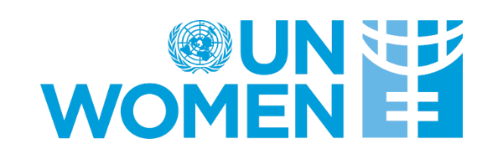

Data Invisibility: A Fundamental Barrier to Progress
Only 27 of 90 surveys
A 2018 UNFPA analysis found data to identify Indigenous women in only 27 out of 90 surveys.
Watch this space! A forthcoming publication by UNFPA, UN Women, and UNICEF with results from 2017–2024 will be available soon.
Slow progress on ethnicity
Surveys including ethnicity questions rose from 48% (2018) to 54% (2024) — but answers are often incomplete or not meaningful.
Policy invisibility
Information gaps translate directly into policy invisibility and risks of not reaching all groups

Slide 4




Disparities Globally
Lower SRH access
Indigenous women and girls had lower access to sexual and reproductive health services than non-Indigenous women in the same countries (2018 UNFPA analysis).
Watch this space! Updated global data from a forthcoming UNFPA, UN Women & UNICEF publication — covering 2017–2024 — will be available soon.
Maternal mortality gap
Anderson et al. (2016): maternal mortality ratio was twice as high or more for Indigenous women in 6 out of 9 countries analyzed.

Slide 5


A Closer Look: Kenya & Norway
DHS 2022
Sápmi / Norway — Nordsletta et al. (2025)
Indigenous = Maasai, Turkana, Borana
First study on midwives' experiences with Sámi women in Northern Norway. 11 interviews. Int. J. Circumpolar Health.
91%
63%
Non-Indigenous
Indigenous women
No ethnicity registry in Norway — Sámi identity not recorded in medical records.
Skilled attendance at birth
Skilled attendance at birth
91%
78%
Non-Indigenous
Indigenous women
Individualised care vs. cultural assumptions
Cultural understanding is complex
Modern contraception use
Modern contraception use
Source: DHS 2022
Equal care for all
Fear of stereotyping
Silence misread as confidence
Sámi culture hard to recognise
Often seen as "extra"
Culture as strength and challenge
Calm childbirth style
Legacy of Norwegianization
Silence shapes care
Main theme: "We are all Norwegians" — can hide real differences and lead to culturally unsafe care.

Slide 6

Why MNH Matters to Indigenous Communities
Barriers are intersecting — medical, cultural, social, and structural.
Lack of Culturally Appropriate, Respectful Services
Other Systemic & Social Barriers
Geographic isolation limits access to skilled attendance
Climate change threatens food security and maternal nutrition
Harmful stigma affects women and mothers with disabilities
Indigenous women underrepresented in health decision-making
Health systems built without Indigenous input
Language barriers reduce access to accurate MNH information
Cultural practices excluded from formal care
Fear of disrespect and mistreatment deters facility births
Maternal and newborn health is not only a medical issue — it is a rights issue, a cultural issue, and a justice issue. CEDAW General Recommendation 39 (2022) calls for culturally appropriate services and recognition of Indigenous health systems.

Slide 7




FOCUS GROUP DISCUSSIONS — INDIGENOUS YOUNG WOMEN, KENYA & GUATEMALA, 2023 (MINORITY RIGHTS GROUP)
What Do Indigenous Women Say?
And If You Are Indigenous and Have a Disability…?
“Those who are pregnant feel the fear and refuse to go to hospital during delivery. If you look at the records, the number of women who deliver at home is higher than ever before.”
“Nurses should be trained on the different kinds of women that they will serve in their healthcare facilities. Staff should help reduce or eradicate stigma. Staff should not be the source of stigma.”
“Some Indigenous women with disabilities do go to the hospitals, but the staff know that most of them don't have money, and they chase them away.”
“The stigma of us being sexual women is one of the reasons why information is not created, the data on how many of us there are does not exist, and we are not involved.”
Intersecting identities — Indigenous, disabled, poor — compound exclusion at every level of the health system.

Slide 8
The Path Forward: Intercultural & Rights-Based Approaches
Respect for Indigenous Practices
Culturally Safe Communication
Health systems must recognize, document, and integrate Indigenous knowledge into maternal care — not displace it.
Language access, culturally concordant care, and trauma-informed approaches are essential — not optional.
Disability-Inclusive Care
Indigenous Women as Decision-Makers
Maternal health services must actively include and accommodate women with disabilities.
Co-design programs with Indigenous women — not for them. Ensure meaningful representation in governance.

Slide 9
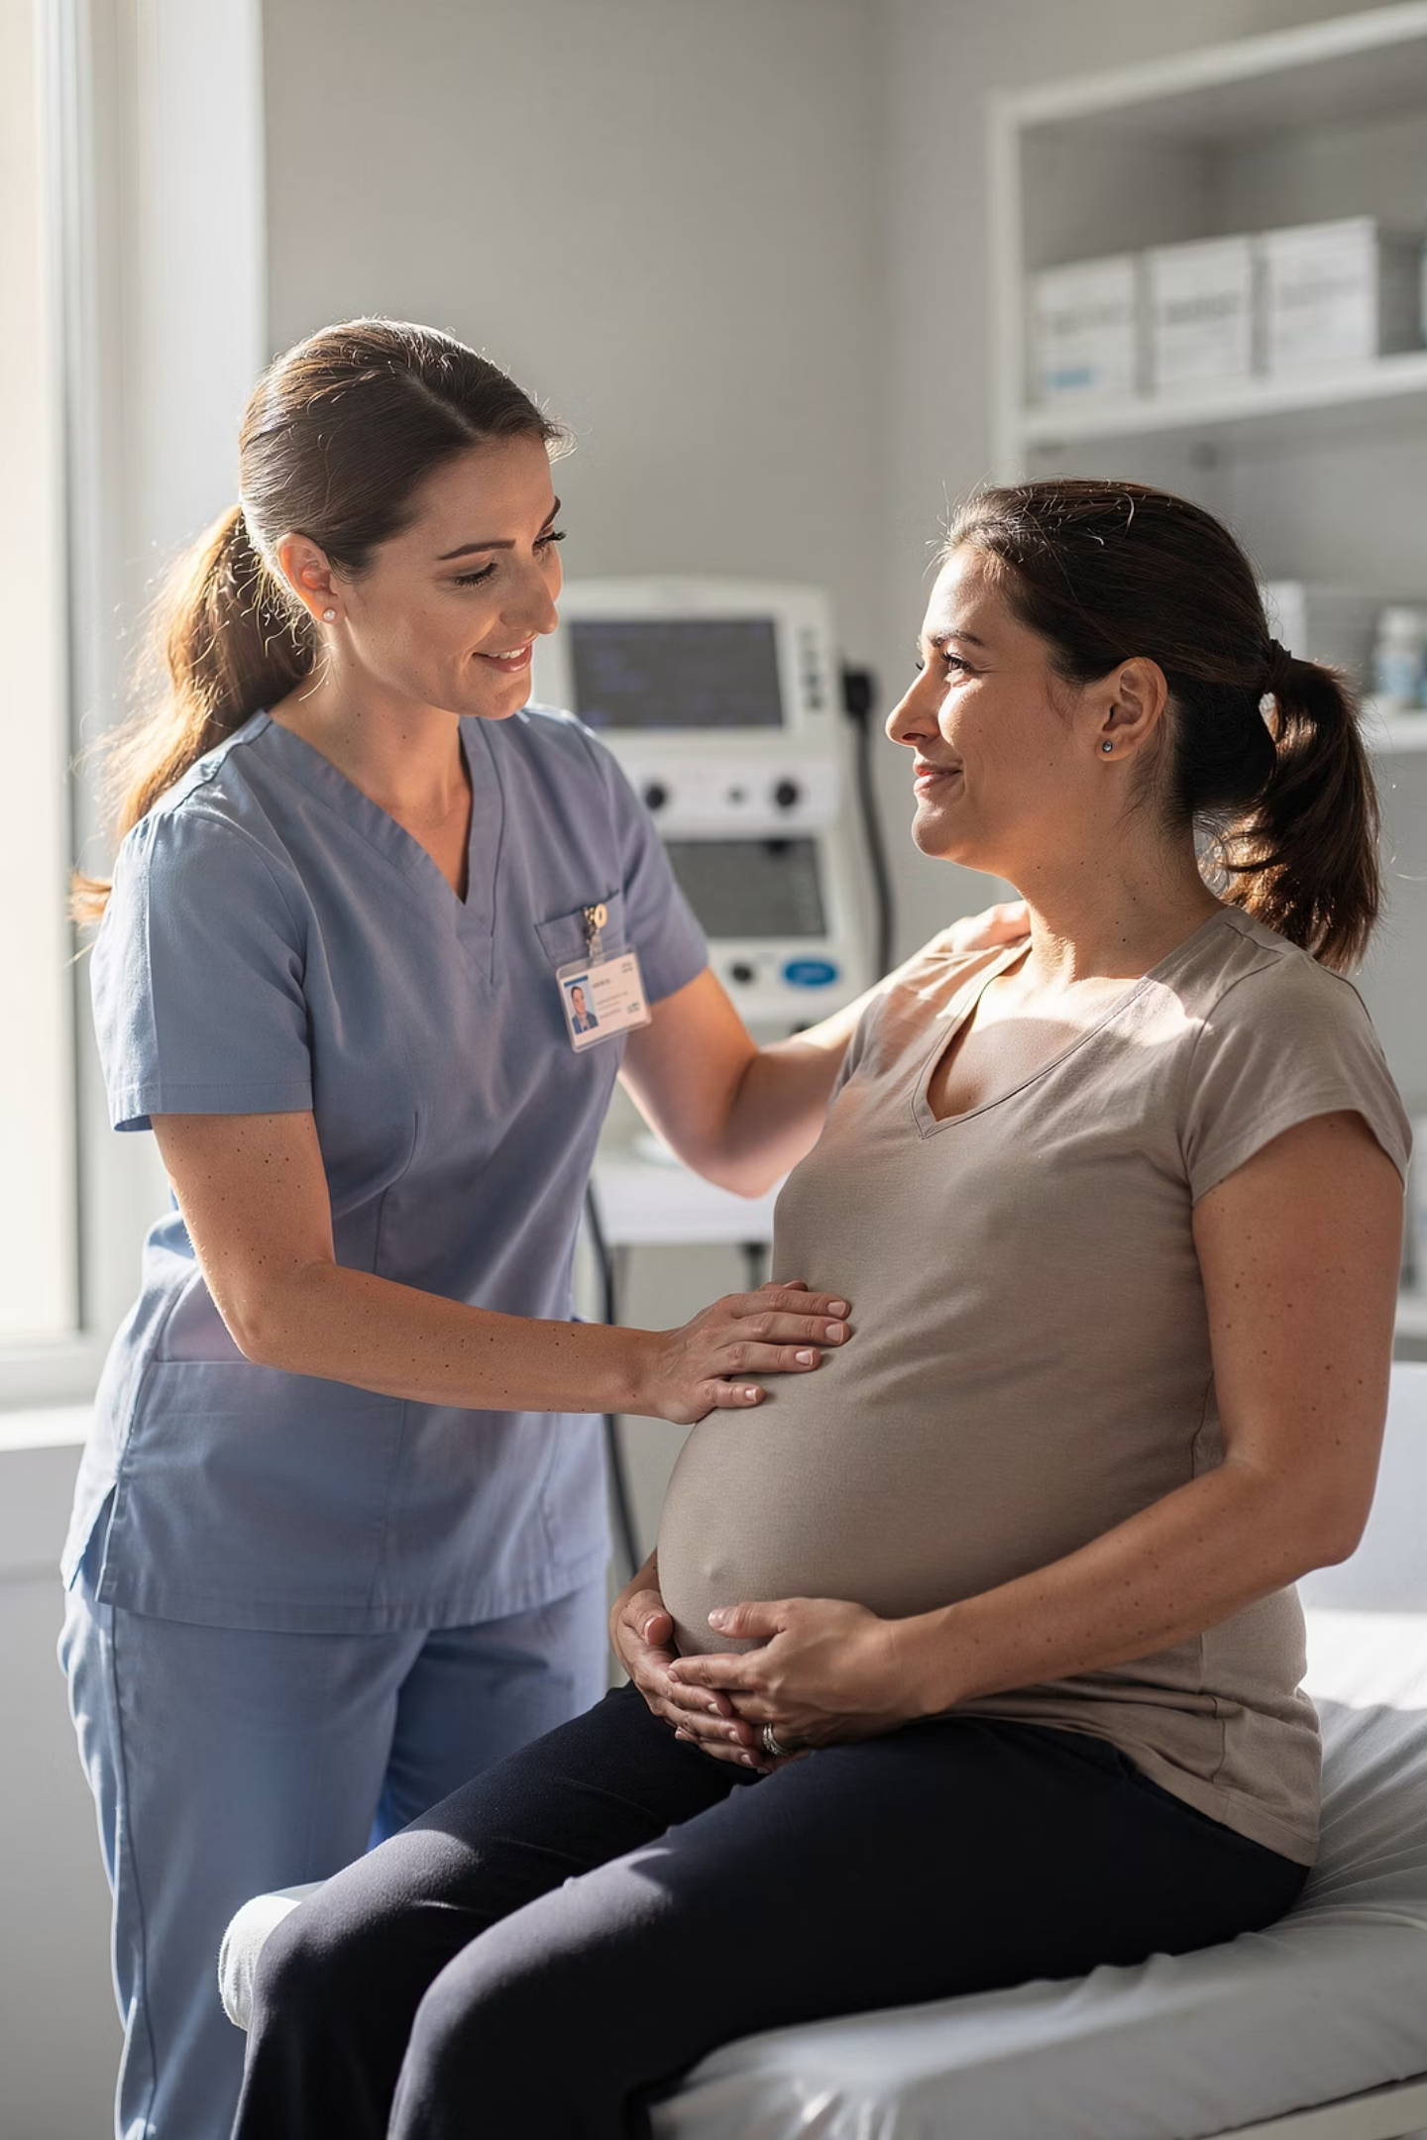
Midwives Are Central to This Change
As midwives, we are often the first and most sustained point of contact for pregnant women — including Indigenous women. We have the power and the responsibility to implement these recommendations in practice.
Recognize, don't erase
Treating everyone "the same" can obscure real and significant differences in cultural context, history, and need.
Build cultural safety — actively
Cultural safety is a skill and a practice, not a checkbox. It must be woven into education and daily clinical encounters.
Advocate beyond the birth room
Midwives can advocate for disaggregated data, equitable resourcing, and rights-based policy at every level.

Slide 10
Gaps We Must Confront Together
01
02
03
Limited access to quality maternal health services and information
Inadequate disability-inclusive maternal care
Lack of culturally responsive healthcare systems
04
05
Underrepresentation of Indigenous women in health decision-making
Insufficient funding directed to grassroots Indigenous and women led organizations

Slide 11

No mother should be left behind because she is Indigenous.
Climate justice is maternal health justice.
Indigenous knowledge must be respected.
Environmental degradation disproportionately harms Indigenous communities — and their mothers and newborns pay the price.
Health systems that disregard Indigenous knowledge fail Indigenous women. Respect is not a courtesy — it is a rights obligation.
MNH systems must be disability-inclusive.
Every woman, including those with disabilities, deserves dignified, accessible, and rights-affirming maternal care.

Slide 12
Call to Action
For governments, health authorities, researchers, and midwifery professionals:
1
2
Invest in disaggregated data
Embed intercultural approaches
States and research institutions must develop statistical methods that accurately measure the impact of ethnicity-related discrimination on health outcomes — including in countries like Norway where ethnicity data is not currently collected.
Health authorities must incorporate intercultural competencies into all state health services and train all maternal health staff accordingly.
3
4
Address racism in healthcare
Co-create — don't prescribe
Human rights and anti-racism training must become core parts of the curricula for all health workers — including midwives.
Design programs with Indigenous women and those with disabilities, not for them. Ensure Indigenous-led organizations are funded and included.

Slide 13

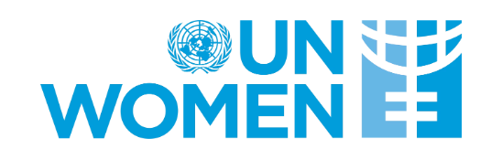

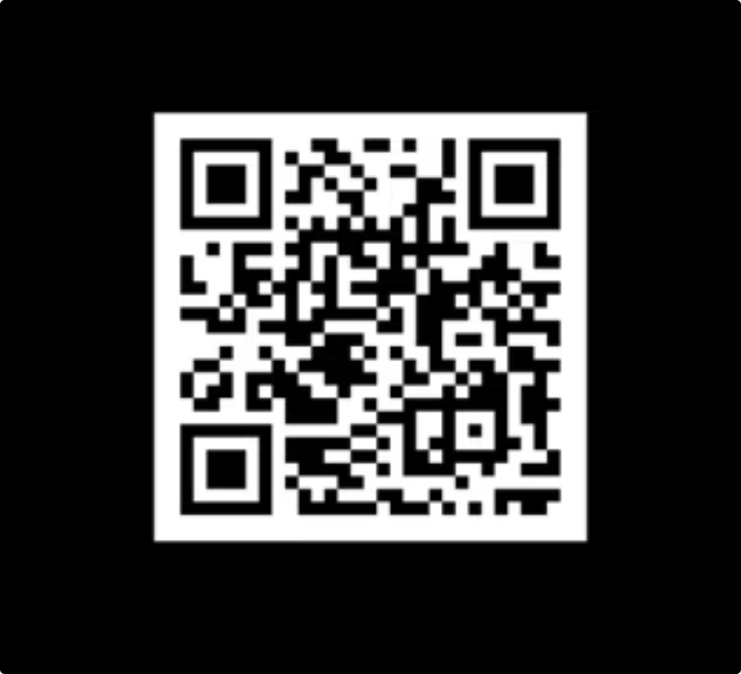
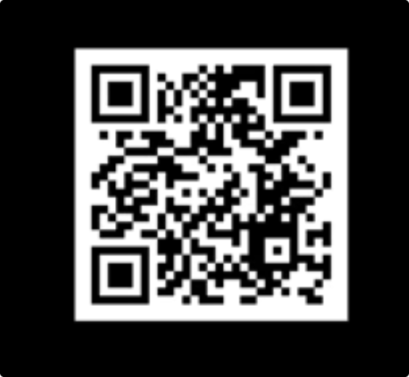
Thank You
Presented at ICM Congress, Lisbon — June 2026
With thanks to UNFPA, UN Women, UNICEF, and Minority Rights Group for their foundational research.
Additional Resources
UNFPA Factsheet — Indigenous Women & Girls
Minority Rights Group — Maternal Voices Report
Key statistics on SRH access and data visibility for Indigenous women globally.
Qualitative testimonies from Indigenous women in Kenya and Guatemala on their experiences of maternal health services.

